Slide 1
NIEM 101 -Technical Introduction to NIEM
This course will introduce business and technical architects, program analysts and information exchange designers and implementers to the National Information Exchange Model (NIEM) and its role in information sharing. The business value of NIEM will be conveyed to participants as well as its history and current use. Participants will be exposed to the structure of NIEM and how it is used across organizations. The role of Information Exchange Package Documentation (IEPDs) will be discussed along with their use in the development of NIEM-conformant information exchanges. The reuse and sharing of IEPDs, both partial reuse and total reuse, will also be discussed.
Course Details
Duration: 2 hours | Target Audience: Architects, Analysts, Implementers and Designers
Prerequisites: None

Slide 2
Technical Introduction to NIEM
NIEM 101
Presenter Name
Presenter’s Organization
Date

Slide 3
NIEM 101 Agenda
Information Sharing
NIEM Overview
NIEM Governance
NIEM IEPD Overview
NIEM Implementation
NIEM Value Proposition
Conclusion

Slide 4
Learning Objectives
This course will inform Architects, Analysts and Implementers about the value and structure of the National information Exchange Model (NIEM).
After this course, you should be able to…
  Identify the origin of information sharing and NIEM
  Explain how NIEM facilitates greater information sharing between organizations
  Describe the governing structure of NIEM and its responsibilities
  Recognize the deliverables associated with NIEM development
  Distinguish the scope of NIEM and its relation to implementation
  Recognize the value that NIEM provides to an organization

Slide 5
Information Sharing

Slide 6
What is Information Sharing?
A police officer pulls you over with lights flashing
The officer asks you for your license and registration
You offer
your excuses for the infraction
The officer is able to run your license and pull up identifiable information about you.
To no avail, the officer walks away to prepare the ticket
Arrest Warrants
Criminal History
DMV
Missing Persons
  Information Sharing refers to the combination of policies, governance, procedures, and technologies that allow different organizations to share important data with each other.

Slide 7
The Need for Information Sharing
Efficient and comprehensive information sharing environments will help organizations…
Improve decision making capabilities by providing more timely and reliable data
Increase organizational agility in response to problems and changing environments
Avoid costs associated with redundant processes and data
Information sharing can improve an organization’s ability to fulfill its mission goals

Slide 8
Information Sharing Progress
  Information Sharing efforts became highly visible following the September 11th terrorist attacks, with legislation reaching its peak between the years of 2001 – 2007.
Congress passes Patriot Act
Terrorist Screening Center created
Executive Order to create the ISE is released
911 Commission Act is enacted
Sept 2001
Oct 2001
Nov 2002
May 2003
July 2004
Oct 2005
Nov 2006
Sept 2007
Terrorist Attacks on US
Congress passes Homeland Security Act
9-11 Commission Report released
ISE Implementation Plan submitted
  Despite these policy shifts, barriers to information sharing still exist, including:
    Lack of consistent policies, standards and practices across government organizations
    Costly, redundant processes
    Lack of a common understanding of data definitions
    Lack of consolidated data for agency-level reporting and decision support
    Lack of trust between government organizations due to poorly communicated data management strategies

Slide 9

The Need for Standards
Lack of standards
will increase cost and redundancy
Inconsistent data definitions
will increase ambiguity and inefficiency
Deficient governance
will increase inconsistencies and limit reuse

Slide 10
Discussion Question:
What problems can NIEM address in your organization?

Slide 11
NIEM Overview

Slide 12
The Need for NIEM
The National Information Exchange Model enables…
Collaboration
Consistency
Development
Support
Brings stakeholders together through reuse and community engagement
Establishes standards for sharing and governance
Supplies tools to aid in discovery and implementation
Provides technical assistance and training
Which Lead To
Lower Development Costs
Enhanced Mission Capabilities
Common Vocabulary
Reduced Maintenance Costs

Slide 13
Background of NIEM
Department of Justice (DOJ) and Department of Homeland Security (DHS) leveraged the GJXDM as a basis for the creation of NIEM in 2005
Global Justice XML Data Model (GJXDM), a Justice- based information sharing standard, was released in 2003
NIEM was launched on February 28, 2005
GJXDM is a Legacy Model
NIEM is the Standard
Notes:
Revising this slide. Will update with new information soon.

Slide 14
Current State of NIEM
  Leadership enables the progressive nature of NIEM to stay the course and meet its objectives.
Leadership is Committed
  The Executive Steering Council (ESC) is in charge of the NIEM Program Management Office (PMO) and has representatives from many different agencies
Infrastructure is Growing
  At the Federal, State, Local, Tribal and Private level there are….
    Training Programs
    Communications and Outreach
    Technical and Business Support
  Model is Continuously Evolving
  Versioning system that continuously updates the NIEM data model
  Iterative process of review; NIEM is never in its “final” state
NIEM is Continuously Improving
  NIEM PMO and other stakeholders are constantly assessing and improving the program

Slide 15
NIEM at a Glance
  NIEM is a Federal, State, Local ,Tribal and Private inter-agency initiative providing a foundation for seamless information exchange. NIEM is more than a data model, it is a community and has a technical and support framework.
Community
Technical Framework
Support Framework
Formal Governance Processes
Data Model
Tools for Development and Discovery
Online Repositories
XML Design Rules
Established Training Program
Mission-Oriented Domains
Development Methodology
Implementation Support
Self-Managing Domain Stewards
Predefined Deliverables (IEPD)

Slide 16
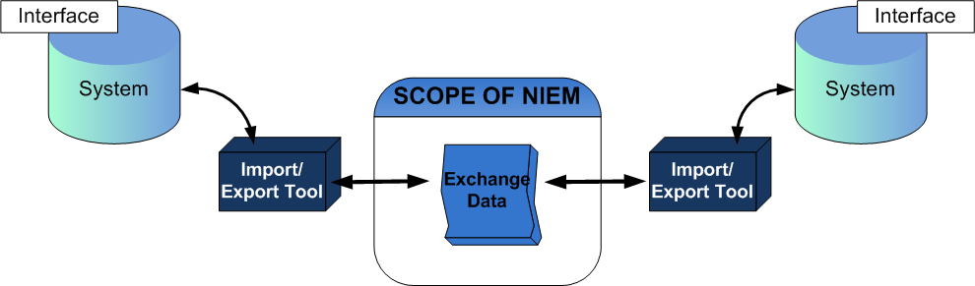
Scope of NIEM
  NIEM is a data layer standard and intentionally does not address all of the necessary technologies needed for information sharing.

Slide 17
The NIEM Data Model
  NIEM’s data model is a set of common, approved XML data elements and definitions vetted through the Federal, State, Local, Tribal and Private Sectors.
Data elements are organized into core and domain-specific components
Core components are used by multiple domains and can be described by structure, semantics, and definition universally
Domain-specific components are continually updated by subject matter experts that are actual NIEM participants and industry experts for their particular domain
NIEM Naming and Design Rules (NDR) specify how each of these components are defined and utilized

Slide 18
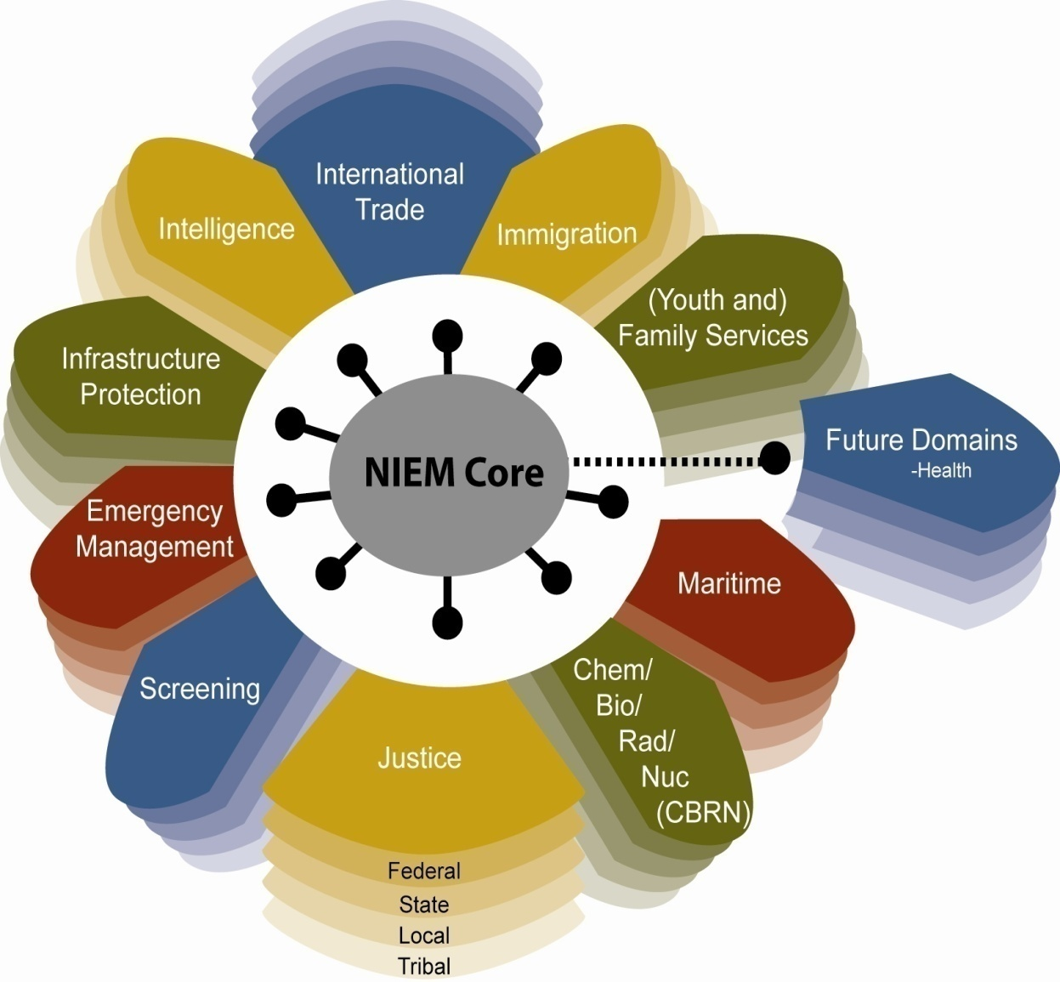
NIEM Technical Architecture
NIEM Core consists of data elements that are commonly understood across domains
NIEM Domains include mission specific data that is managed through independent stewards
Future Domains are added to NIEM as necessary based on an established need

Slide 19
NIEM Core Components
Some important, practical NIEM Core components
<nc:Person>
<PersonSexCode>
<PersonBirthDate>
<PersonEyeColorText>
<PersonHairColorText>
…
<nc:Activity>
<ActivityDate>
<ActivityCategoryText>
<ActivityDescriptionText>
<ActivityDisposition>
…
<nc:Item>
<ItemName>
<ItemDescriptionText>
<ItemConditionText>
<ItemValue>
…
Has the most fields
The most often derived component
Has the deepest inheritance chain
<nc:Identification>
<IdentificationID>
<IdentificationJurisdictionText>
<IdentificationEffectiveDate>
<IdentificationStatus>
…
<nc:Location>
<LocationDescriptionText>
<LocationAddress>
<LocationCategoryCode>
<LocationName>
…
<nc:Organization>
<OrganizationName>
<OrganizationDescriptionText>
<OrganizationCategoryText>
<OrganizationEstablishedDate>
…

Slide 20
NIEM Core Component – <nc:Person>
Approximately 200 discreet fields for Person information across all domains
<nc:PersonNameType>
<PersonNamePrefixText>
<PersonGivenName>
<PersonMiddleName>
<PersonSurName>
…
<nc:Person>
<PersonName>
<PersonSex>
<PersonBirthDate>
<PersonHairColor>
<PersonPhysicalFeature>
<PersonCapability>
<PersonSSNIdentification>
<PersonInjury>
<PersonMedicalCondition>
…
<nc:PhysicalFeatureType>
<PhysicalFeatureCategory>
<PhysicalFeatureDescriptionText>
<PhysicalFeatureImage>
<PhysicalFeatureLocationText>
…
<nc:InjuryType>
<InjuryCategoryText>
<InjuryDate>
<InjuryDescriptionText>
<InjuryLocationText>
<InjurySeverityText>
<InjuryTreatmentText>
…
<nc:MedicalConditionType>
<MedicalConditionText>
<MedicalConditionCauseText>
<MedicalConditionDescriptionText>
<MedicalConditionSeverityText>
…

Slide 21
NIEM Core Component – <nc:Activity>
<j:ServiceCall>
<ServiceCallArrivedDate>
<ServiceCallClearedDate>
…
<nc:Activity> has approximately 60 different derived types in NIEM
Derived types inherit all parent fields
Field meaning depends on context
<nc:Activity>
<ActivityDate>
<ActivityCategoryText>
<ActivityDescriptionText>
<ActivityDisposition>
…
<nc:Incident>
<IncidentLocation>
<IncidentObservationText>
…
<j:Arrest>
<ArrestSubject>
<ArrestCharge>
…
<j:Citation>
<CitationFineAmount>
<CitationViolation>
…
<em:AlarmEvent>
<AlarmEventCategoryCode>
<AlarmEventDetailsText>
…
<j:Booking>
<BookingArraignmentDate>
<BookingSubject>
…

Slide 22
NIEM Core Component – <nc:Item>
<nc:TangibleItem>
<ItemColor>
<ItemMakeName>
<ItemModelName>
<ItemModelYearDate>
…
<nc:Item>
<ItemName>
<ItemDescriptionText>
<ItemValue>
…
<nc:Firearm>
<FirearmMakeCode>
<FirearmCaliber>
<FirearmGaugeText>
…
Longest inheritance chain (up to 4 levels)
Approximately 20 different classes of items in NIEM
<nc:Conveyance>
<ConveyanceMotorizedIndicator>
<ConveyanceUse>
…
<nc:Substance>
<DrugCategoryCode>
<SubstanceQuantityMeasure>
…
<nc:Vehicle>
<VehicleIdentification>
<VehicleMakeCode
<VehicleModelCode>
…
<nc:Vessel>
<VesselHullIdentification>
<VesselHullShapeText>
<VesselHullMaterialText>
…
<nc:Aircraft>
<AircraftTailID>
<AircraftFuselageColor>
<AircraftWingColor>
…
<nc:Drug>
<DrugStrengthText>
<DrugDaysSupplyText>
<DEAClassScheduleCode>
…

Slide 23
NIEM Governance

Slide 24
NIEM Governing Structure
NIEM’s governing structure is comprised of Federal, State, Local, Tribal and Private organizations
NIEM is jointly managed at an executive level by the Department of Homeland Security (DHS) and the Department of Justice (DOJ)
ESC
Executive Steering Council
NIEM PMO
Executive Director
Deputy Director
NC&OC
NTAC
NBAC
NIEM Communications & Outreach Committee
NIEM Technical Architecture Committee
NIEM Business Architecture Committee

Slide 25

Communities of Interest
  Communities of interest (COIs) are collaborative groups of users who exchange information in pursuit of shared goals, interests, missions, or business processes and who, therefore, must have a shared vocabulary for the information they exchange.
Coordination is an important aspect of NIEM
  COIs reuse data components and artifacts found in NIEM to document their information exchanges
  One or more COIs can coordinate to develop new domain content needed for documenting information exchanges

Slide 26
Domain Governance
  Domain refers to a business enterprise broadly reflecting the agencies, units of government, operational functions, services, and information systems that are organized or affiliated to meet common objectives.
  NIEM domains are mission-based and organized to facilitate governance, and each has some measure of compliance
Domain stewards are community members responsible for actively managing and updating their community’s data model
Each domain traditionally includes a cohesive group of domain stewards who are part of a Community of Interest

Slide 27
Discussion Question:
Why is NIEM governance so important?
What problems can arise without a governance structure in place?

Slide 28
NIEM IEPD Overview

Slide 29
What is an IEPD?
  An Information Exchange Package Documentation (IEPD) is a collection of artifacts that describe the construction and content of an information exchange
      Developed to provide the business, functional, and technical details of the information exchange through predefined artifacts
      Created with a core set of artifacts in a prescribed format and organizational structure to allow for consistency
      Designed to be shared and reused in the development of new information exchanges through publication in IEPD repositories

Slide 30


Scope of IEPDs
IEPDs contain design specifications for an information exchange but may not include supplementary information such as implementation decisions.
IEPDs do
IEPDs do not
  Include the XML schemas that define the XML message structure
  Contain standardized artifacts that document an information exchange
  Have a defined development methodology (IEPD Lifecycle)
  Ease the documentation process for reuse
  Specify how exchange data is physically transferred between entities
  Describe an interface or Interface Control Document (ICD)
  Specify any technical information outside of the message structure

Slide 31


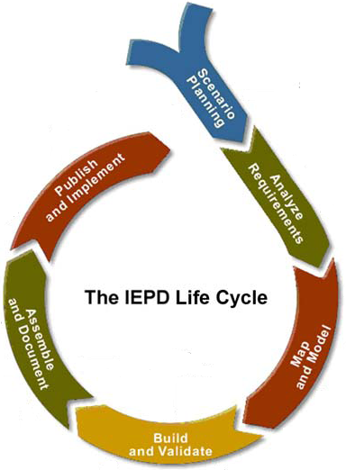



The IEPD Lifecycle
Scenario Planning
Plan the project, establish the process, and identify information exchange business requirements
Analyze Requirements
Selected information exchange is further elaborated to understand and document the business context and data requirements
Map & Model
Associate local objects with types and elements in NIEM. This process is called mapping an exchange content model to NIEM
The IEPD Lifecycle
Build & Validate
Create a set of exchange-specific NIEM conformant XML schemas that implement the data model created for the exchange
Assemble & Document
Prepare and package all related files for this IEPD into a single self‐contained, self-documented, portable archive file
Publish & Implement
Publish IEPD for search, discovery, and reuse

Slide 32

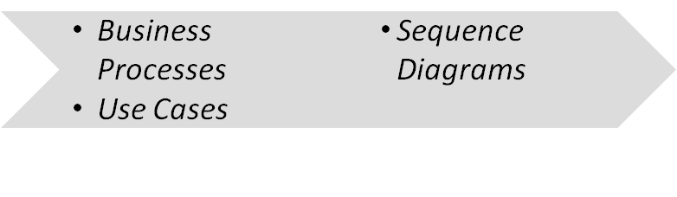

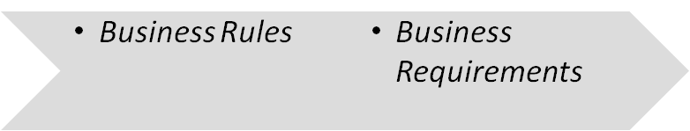

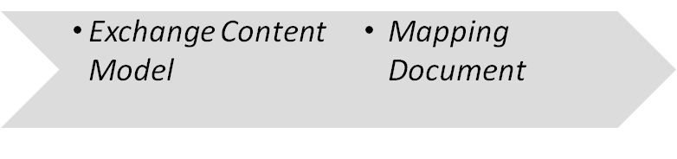

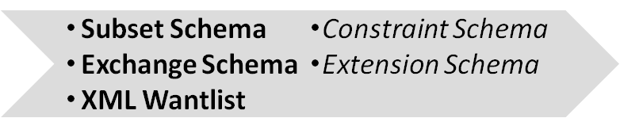

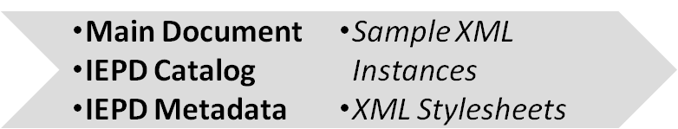

The IEPD Artifacts
Scenario Planning
  IEPDs contain both required and recommended artifacts
  Required : Bold
  Recommended : Italic
  Note: Best practices for most organizations include many of the optional artifacts listed here
Analyze Requirements
Map & Model
Build & Validate
Assemble & Document
Publish & Implement
No required artifacts. Publish the IEPD to a repository and implement the exchange

Slide 33
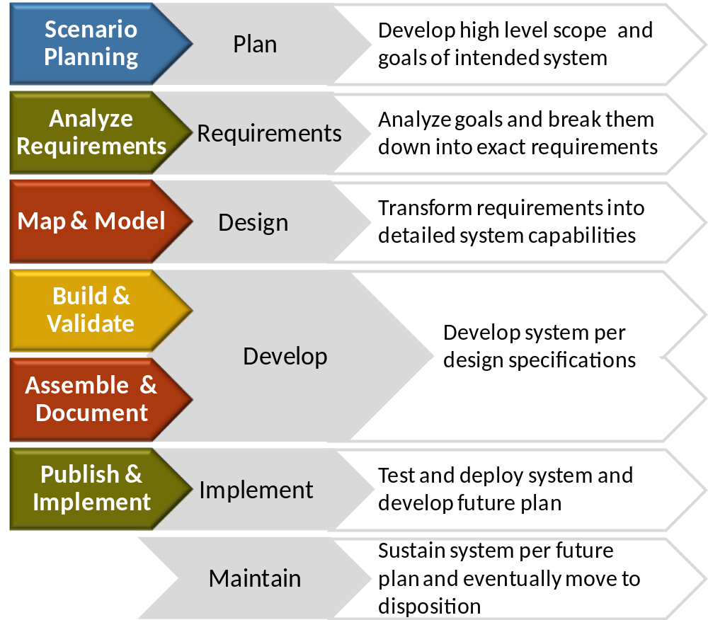
Systems Development Life Cycle
  The Systems Development Life Cycle (SDLC) is a common methodology used for creating software
  The IEPD Lifecycle integrates closely with the phases of the SDLC

Slide 34
IEPD Reuse and Sharing
Existing IEPDs, after publication, can be reused in the creation of new IEPDs which can:
  Decrease IEPD development time
  Increase consistency of data definitions
  IEPD repositories (DHS Data Architecture Repository (DAR), IEPD Clearinghouse, etc.) can be leveraged to search and reuse existing IEPDs
IEPD
  Artifacts within IEPDs can be leveraged to facilitate development and ease the burden on resources
Artifact
  Elements in the NIEM data model can be reused within specific exchanges; domain governance efforts add new elements to the model
Elements

Slide 35
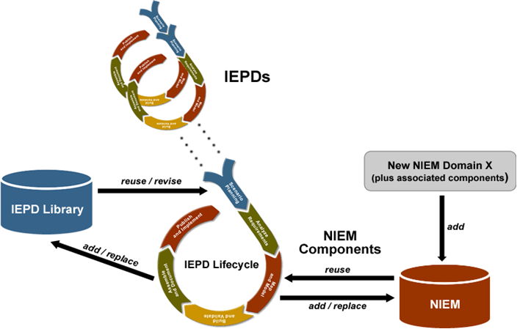
IEPDs and the NIEM Architecture
  NIEM continues to grow and evolve with practitioners’ contributions

Slide 36
NIEM Implementation

Slide 37
NIEM and Implementation
In order to provide infrastructure flexibility, NIEM does not define implementation specifications
NIEM defines the format and structure of data in transit
Exchange partners decide how to store and process the NIEM-conformant data being exchanged
NIEM can be established within an organization’s Service Oriented Architecture (SOA) as a data standard for all information exchanges
Security and privacy should be key considerations when implementing an exchange

Slide 38
SOA and NIEM
Service Oriented Architecture (SOA) is an architectural style whose goal is to achieve loose coupling among interacting software agents.
  NIEM provides the standard for data layer interoperability among services in SOA
  NIEM can be used to standardize and structure the messages passed between services in SOA
  NIEM can decrease development time of new services in SOA through reuse of similar IEPDs
Service Oriented Architecture
Distributed
Loosely Coupled
Standards-Based
Process-Oriented

Slide 39
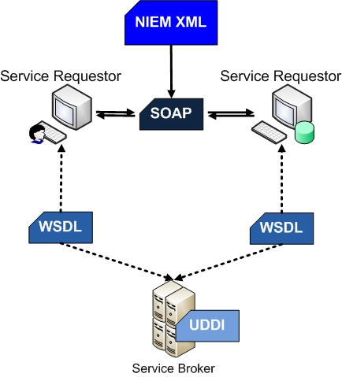
Information Exchange Implementation
NIEM XML
NIEM-conformant XML instance that contains the actual data to be shared between web services
SOAP
Simple Object Access Protocol is an XML-based protocol for exchanging messages in web services
WSDL
Web Services Description Language is an XML-based language that provides a model for describing Web services
UDDI
The diagram above represents only one of the ways to implement an information exchange
Universal Description, Discovery, and Integration is an XML-based registry of web services

Slide 40
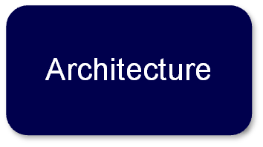
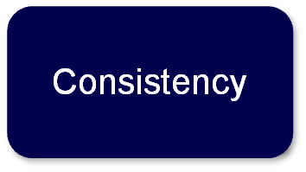
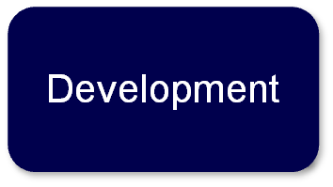
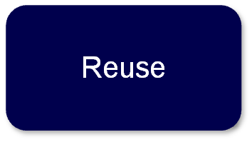
Best Practices in Implementation
Systems on either side of the exchange can use different implementation architectures (i.e. different programming languages, operating systems)
All participants in an exchange must agree on the definition and structure for the data in the exchange - NIEM provides this standard
IEPD Lifecycle should be used to guide development of NIEM-conformant exchange to make sure all of the necessary artifacts are created
Elements already defined within NIEM should be used whenever possible; exchange elements outside of NIEM should also be reused whenever possible

Slide 41


Security and Privacy
  Intelligence Community Metadata Standard for Information Security Marking (IC-ISM) sets standards for security marking metadata and classified information
  Metadata mechanism in NIEM 2.1 provides a method for using IC-ISM attributes
  Encryption of information exchanges is not within the scope of NIEM. NIEM can be used to structure the XML before encryption
Security
  Avoid transmission of sensitive or personally identifiable information (PII) whenever possible
  Privacy Offices in many federal agencies set detailed standards and guidelines for the sharing of PII
Privacy

Slide 42
NIEM Value Proposition

Slide 43

Value through Community Growth
  Increasing adoption by government agencies as the standard for information exchanges
    OMB Mandates requiring the use of NIEM in many Federal Agencies
    Majority of states use NIEM
  NIEM PMO and other NIEM committees continue to grow and evolve to serve the community
  Increasing participation leads to growth in the NIEM data model and increased ability to share information and reuse existing data components
Growth of community further solidifies NIEM as a standard and increases its value

Slide 44

Value Proposition - Interoperability
  The interoperable nature of NIEM establishes:
Common Language and Vocabulary
Agnostic Implementation
  Eliminates confusion by providing consistency of data definitions between agencies
  NIEM does not dictate how agencies’ systems are implemented, but enables these systems to work together
  Core Biographic (Department of Homeland Security)
  The Core Biographic Person Identify Data Elements (CBPIDE) IEPD was created as a standard base set of person data available for reuse both within and outside of DHS
  The interoperability of the Core Biographic IEPD has given components of DHS the ability to share information using common vocabulary without limiting its use by promoting a specific implementation specification

Slide 45

Value Proposition - Reusability
  The reuse of IEPDs, in part and whole, within NIEM will:
Decrease Development Time
Increase Consistency
  Decreases the development time for information exchanges that use similar sets of data
  Allows practitioners to increase the level of consistency in data definitions across their information exchanges
  Texas Path to NIEM
  Completion of 28 NIEM-conformant information exchanges to serve as the foundation for statewide information sharing using NIEM
  State and local organizations can reuse these 28 critical exchanges to implement systems that support these exchanges and facilitate greater information sharing
  Reuse of common business data components across the 28 exchanges resulted in a high level of consistency of data definitions

Slide 46

Value Proposition - Standardization
  The formalization of NIEM as a standard enables:
Large Support Community
Structured Approach
  NIEM Practitioners can leverage NIEM’s large support community to decrease development time for exchanges and increase conformance
  Repeatable approach that decreases the inconsistencies and duration of development
  Pennsylvania JNET (Justice Network)
  Converted existing data exchanges from GJXDM to NIEM, providing project and development methodology guidance on JNET message development projects
  Created repeatable NIEM message development process
  Contributed documentation back to NIEM community to guide future NIEM implementation efforts

Slide 47
NIEM’s Overall Value:
Organizations with vastly different IT systems and data models can share information with ease.

Slide 48
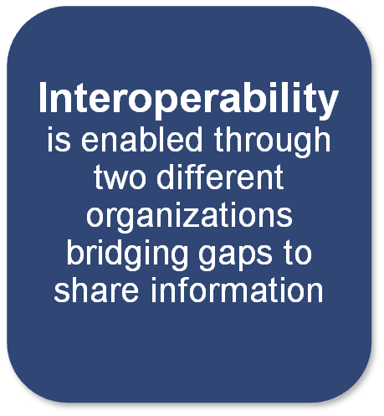

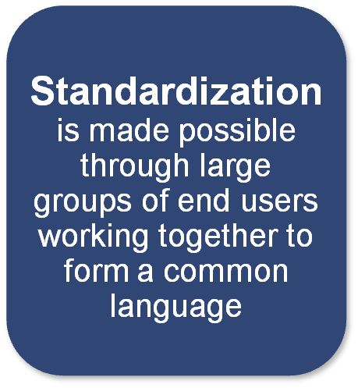

A Call to Action
  NIEM is established, continues to grow, and is the answer to information sharing only because of…

Slide 49
Discussion Question:
What value will NIEM bring to your organization?

Slide 50
Conclusion

Slide 51
Learning Recap
This course should have informed Architects, Analysts and Implementers about the value and structure of the National information Exchange Model (NIEM).
You should be able to…
  Identify the origin of information sharing and NIEM
  Explain how NIEM facilitates greater information sharing between organizations
  Describe the governing structure of NIEM and its responsibilities
  Recognize the deliverables associated with NIEM development
  Distinguish the scope of NIEM and its relation to implementation
  Recognize the value that NIEM provides to an organization

Slide 52

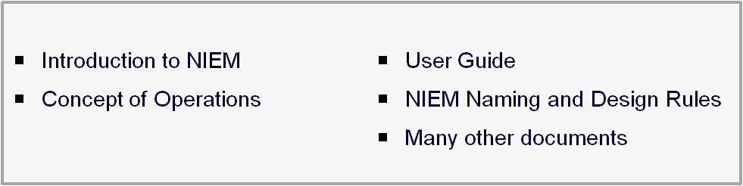


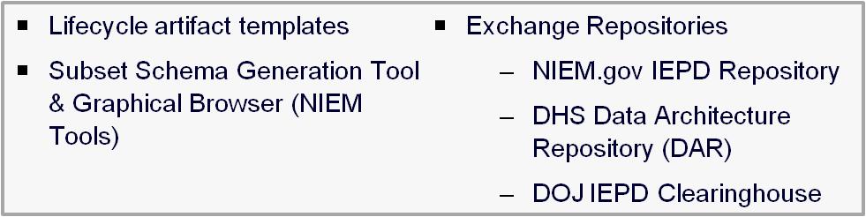
Additional NIEM Resources
  NIEM.gov contains a collection of essential NIEM documents
  Many resources are available to provide support and assistance
  NIEM website offers recorded sessions and lecture material
  NIEM Training is Available
  National Information Sharing Standards (NISS) Knowledge Base and Help desk

Slide 53
End of Course

